Slide 1
INTRO TO AI (FINAL PROJECT PROPOSAL)
Covid 19 Detection Using Symptoms
Presented By:
Chaitanya Yadavally (50051123)
Chaitanya Veeragandhapu (50046401)
Rohit Tripuraneni (50048476)

Slide 2

GOAL
To train a model to predict Covid-19 positive or negative based on symptoms.
To minimize the chance of Positive person is being classified as Negative (i.e minimizing False positive < 5 )..
Implementing machine learning model for classifying the records in the dataset correctly, consistently and time efficiently.

Slide 3
OBJECTIVE
To design the best model such that it can predict the target accurately by comparing the results of individual model.
To implement various machine learning algorithms such as
Support Vector Machines.
Decision Tree(J48)
Logistic Regression
KNN

Slide 4
Data Preprocessing
Data Acquisition (web
source)
(Data cleaning, normalisation and feature engineering)
1
2
4
3
Target Prediction (Model testing and accuracy prediction)
Model Fitting (Dataset splitting, Cross validation
and Model training )
Approach
TOOLS: Anaconda (Jupyter notebook)

Slide 5
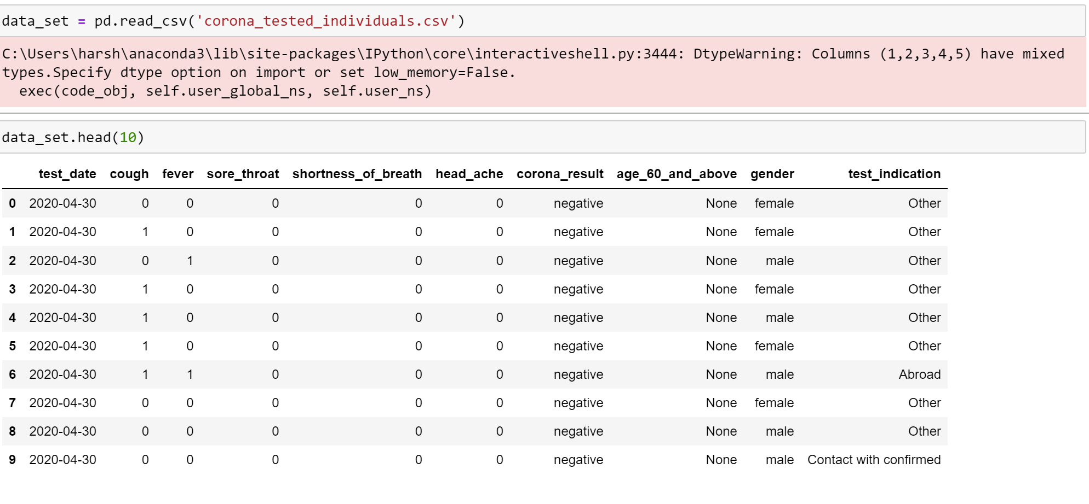
DATASET
https://data.gov.il/dataset/covid-19 (English) – Dataset Taken From
https://www.kaggle.com/datasets/imdevskp/corona-virus-report - For Futhur Research.

Slide 6
Evaluation Methodology
Confusion Matrix : for finding False Positive, True Positive, false Negative, True Negative
F1-score
Accuracy(>95)
Time Complexity
Correctness
Feature importance: You can measure the role of each feature in your final model using either built-in or external feature importance algorithms.
Decision boundary visualization

Slide 7
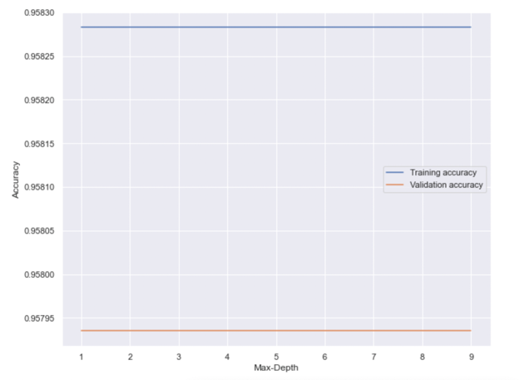
J48

Slide 8
KNN
Correctly classified instances – 95.09%
Incorrectly classified instances – 4.91%
R2 score – 0.383
Time taken – 83.78s

Slide 9
Logistic Regression
Correctly classified instances – 95.06%
Incorrectly classified instances – 4.94%
R2 score – 0.33
Time taken – 7.75s

Slide 10
SVM
Correctly classified instances – 95.80%
Incorrectly classified instances – 4.20%
R2 score – 0.41
Time taken – 479s

Slide 11
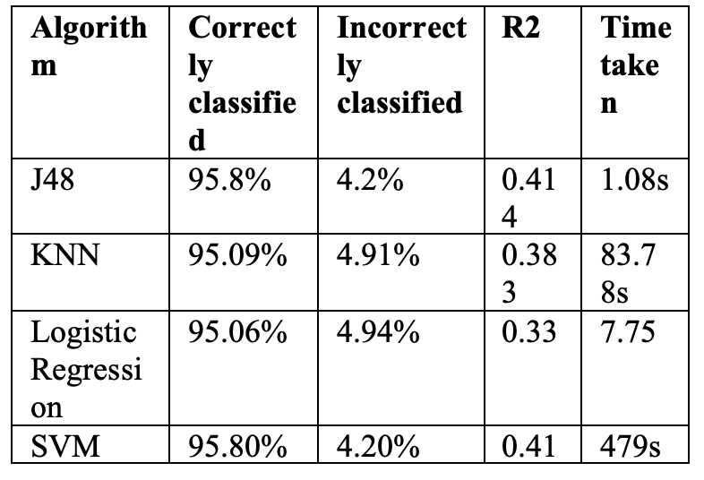
COMPARATIVE STUDY OF ALL ALGORITHMS EVALUATED

Slide 12
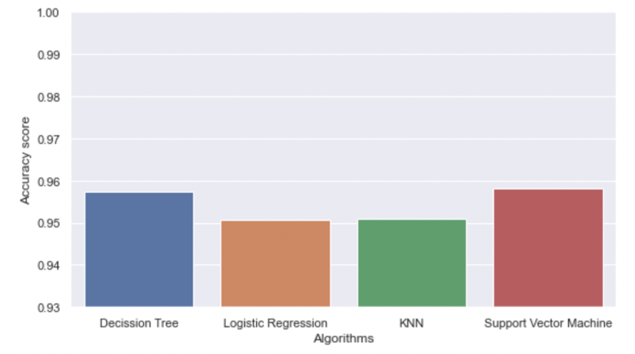
Algorithms vs Accuracy Scores

Slide 13
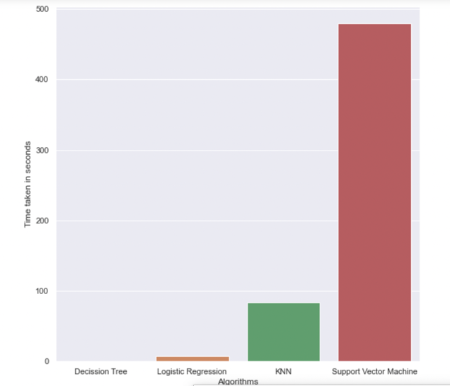
Algorithms vs Time Complexity

Slide 14
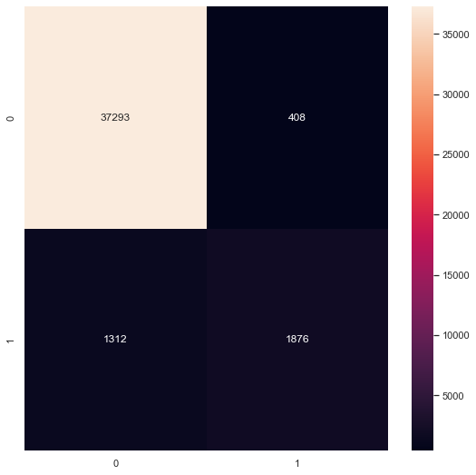
Confusion Matrix
{0,0} False Negative {0,1} False Positive {1,0} True Negative {1,1} True Positive

Slide 15
Conclusion
The final aim is to develop a model that employs the most effective machine learning approach for forecasting COVID-19. Also our goal is to give efficient and trustworthy prediction with fewer characteristics and testing. In this study, just nine crucial features are taken into account. Four distinct classification techniques were utilized. Some of the approaches employed include support vector machine, K closet neighbors, logistic regression and decision tree. Before being used in this model, the data was pre-processed. The support vector machine and decision tree are the strategies that give the best results in this paradigm. However , decision trees were explored since they have a reduced time complexity. To widen this, other methodologies like clustering, association rules and genetic algorithms might be applied. Given the limits of this study, there is a need to develop a more complicated and combination of models to achieve greater accuracy for COVID-19 early prediction.

Slide 16
References
S. L. S, A. H. S. and V. c. S. S., “Nature inspired optimization model for classification and severity prediction in COVID-19 clinical dataset,” Journal of Ambient Intelligence and Humanized Computing , pp. 1-13, 2021.
R. Sardar, A. Sharma1 and D. Gupta1*, “Machine Learning Assisted Prediction of Prognostic Biomarkers Associated With COVID-19, Using Clinical and Proteomics Data,” Systems Biology and Omics Approaches to Understand Complex Diseases Biology, pp. 1-10, 2021.
S. N. Ahmed, “Covid, AI, and Robotics - A Neurologist's Perspective,” Front. Robot. AI, pp. 1-4, 2021.
S. Raje, N. Reddy, H. Jerbi, P. Randhawa, G. Tsaramirsis, N. V. Shrivas, A. Pavlopoulou, M. Stojmenović and D. Piromalis, “Applications of Healthcare Robots in Combating the COVID-19 Pandemic,” Applied Bionics and Biomechanics, pp. 1-9, 2021.
S. SENHAJI, S. FAQUIR and M. O. Jamil, “Towards robotics and artificial intelligence for the prevention of Covid 19 pandemic,” E3S Web of Conferences , pp. 1-8, 2021.
D. M. Matta and M. K. Saraf, “Prediction of COVID-19 using Machine Learning Techniques,” Bachelor of Science in Computer Science, pp. 1-20, 2020.
C. N. Villavicencio, J. J. E. Macrohon, X. A. Inbaraj, J.-H. Jeng and J.-G. Hsieh, “COVID-19 Prediction Applying Supervised Machine Learning Algorithms with Comparative Analysis Using WEKA,” Algorithms, pp. 1-22, 2021.
F. E. Shamout, Y. Shen, N. Wu, A. Kaku, J. Park, T. Makino, S. Jastrzębski, J. Witowski, B. Z. Duo Wang, S. Dogra, M. Cao, N. Razavian and D. Kudlowitz, “An artificial intelligence system for predicting the deterioration of COVID-19 patients in the emergency department,” npj Digital Medicine volume , pp. 1-11, 2021.
D. Painuli, D. Mishra, S. Bhardwaj and M. Aggarwal1, “Forecast and prediction of COVID-19 using machine learning,” Data Science for COVID-19. , p. 381–397, 2021.
L. Wang, Y. Zhang, D. Wang, X. Tong, T. Liu, S. Zhang, J. Huang, L. Zhang, L. Chen, H. Fan and M. Clarke, “Artificial Intelligence for COVID-19: A Systematic Review,” Medicine, pp. 1-9, 2021.
L. R. Kolozsvári, T. Bérczes, A. Hajdu, R. Gesztelyi, A. Tiba, I. Varga, A. B.Al-Tammemi, G. J. Szőllősi, S. Harsányi, S. Garbóczy and J. Zsuga, “Predicting the epidemic curve of the coronavirus (SARS-CoV-2) disease (COVID-19) using artificial intelligence: An application on the first and second waves,” Informatics in Medicine Unlocked, pp. 1-6, 2021.
P. Guleria, S. Ahmed, A. Alhumam and P. N. Srinivasu, “Empirical Study on Classifiers for Earlier Prediction of COVID-19 Infection Cure and Death Rate in the Indian States,” Healthcare (Basel)., pp. 1-8, 2022.

